Slide 1
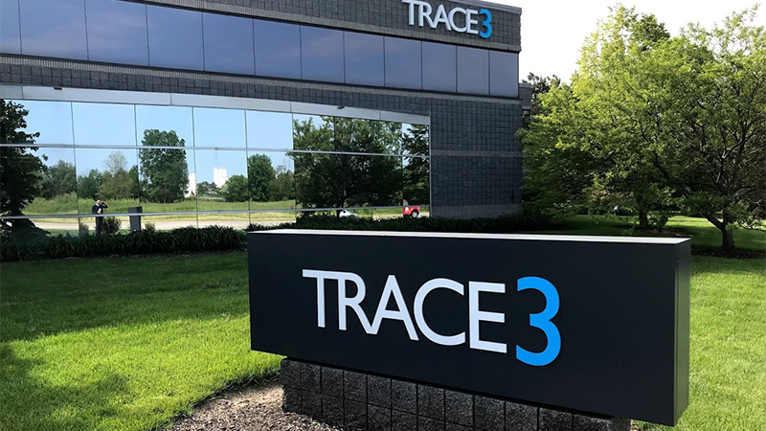
BUDT 748
TEAM 1
Meeting Management
Tool

Slide 2


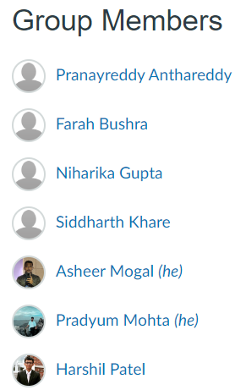

Agenda
# | Agenda Items
1 | Project Progress
2 | Project Management / Team Development
3 | Client Support / Business Analysis
4 | Data Analysis / Architecture
5 | User Interface (UI/UX)
6 | Technical Development / Architecture
7 | Q&A

Slide 3
Trace3 Meeting Management Tool - Project Progress
Trace3 Collaboration: Held 3 productive meetings to align project goals and clarify requirements.
Environment Setup: Communicated and documented necessary environment prerequisites
Azure Access: Met with Javas; currently awaiting access to Azure resources. We’ll start database designs after we get this access.
Frontend Development: Already started work on the Initial designs.
Backend Development: Started implementing core backend functionalities using Django.

Slide 4
Project Management & Team Development
Team is using MS Teams Planner for project progress tracking.
Tasks are assigned based on team members' roles.
Google Sheets is utilized to track sprints and work.
Weekly check-ins within the team ensure task lists and information are current.
Implementation phase is expected to be completed by mid-November, pending access to client's system.

Slide 5
Client Support / Business Analysis
Non-disclosure agreement (NDA) has been signed by all team members.
Team is having bi-weekly video conferencing meetings with the Trace3 Client team (Ellen, Lindsey, Javas)
Primary mode of communication is email.
The client has agreed to track project progress using two-week long sprints to adhere with the timeline and ensure project delivery by December 2024.
Our team is using the MS Teams Planner to keep a track of tasks, issues, blockers, spillovers and overall project progress.
We are working on creating a teams channel on MS Teams which will also include members from the client team, to ease the communication process.

Slide 6
Data Analysis / Architecture
1. Database Architecture:
Relational Databases: MySQL will be used to store meeting.The database schema includes entities such as Meetings, Participants, Survey Responses, and Analytics.
Caching: Redis will be used for temporary data storage and faster data retrieval.
Data Integration: Data is synced in real-time across different platforms (calendar, video conferencing tools) through automated API calls.
2. Data Pipelines:
Data will be collected from multiple sources, including Outlook Calendar, WebEx, MS Teams, and Zoom.
Scheduled Meeting Data: Gathering recurring meetings using scheduled cron jobs from Outlook Calendar.
Instant Meeting Data: Capturing ad-hoc meetings not scheduled in the calendar via APIs (e.g., Fireflies integration for real-time data).
Participants Data: Collecting participant attendance and engagement metrics for all meetings using APIs from integrated platforms.

Slide 7
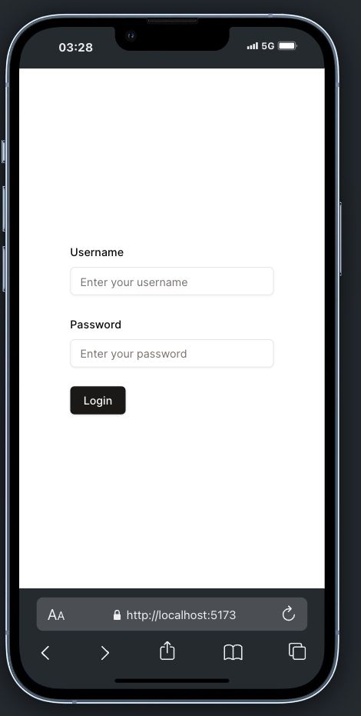
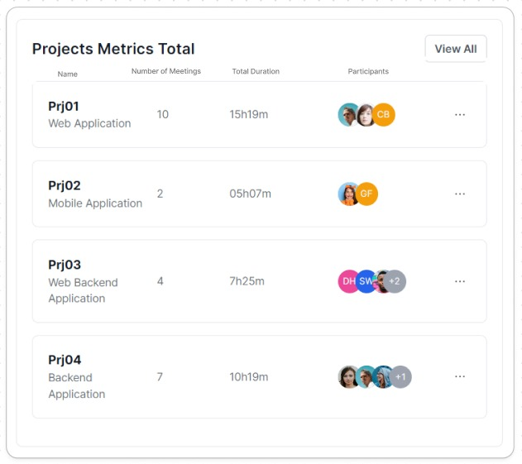
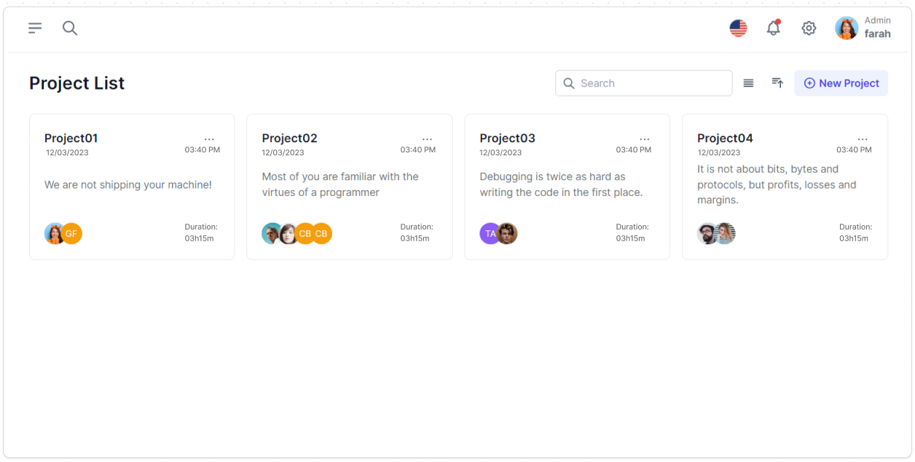
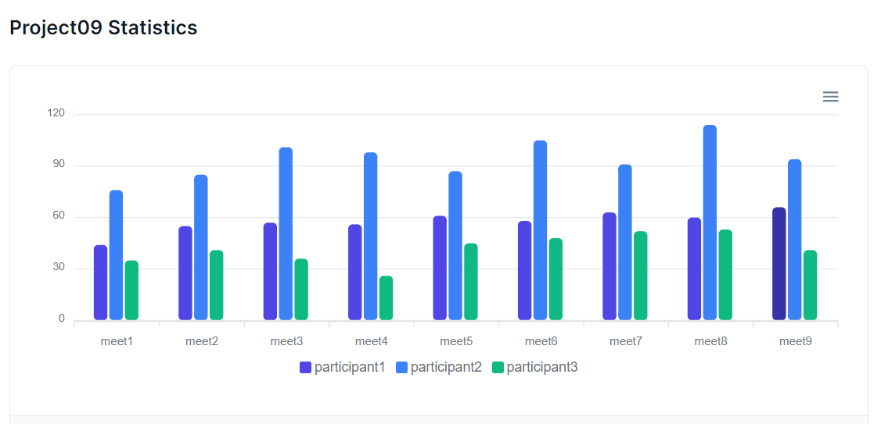
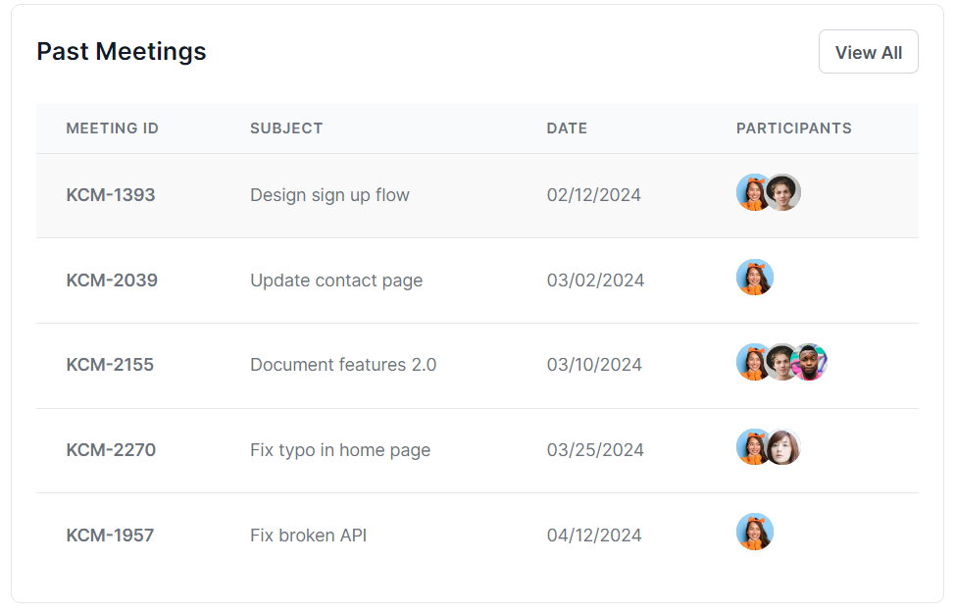
User Interface (UI/UX)

Slide 8
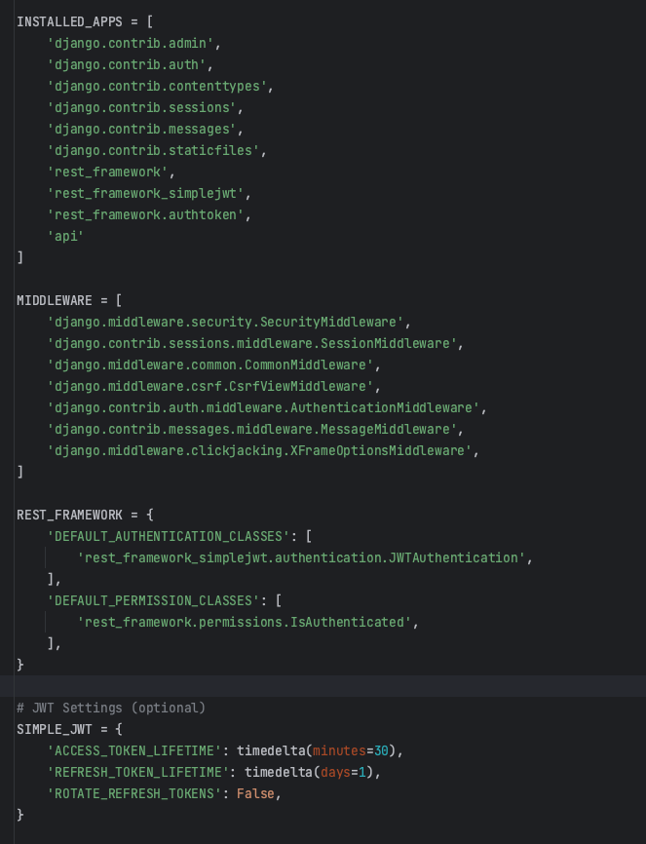
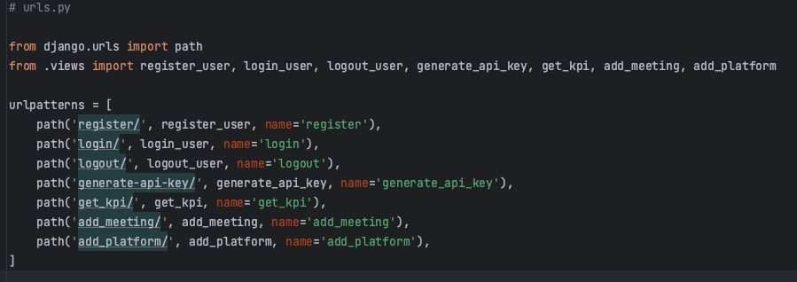
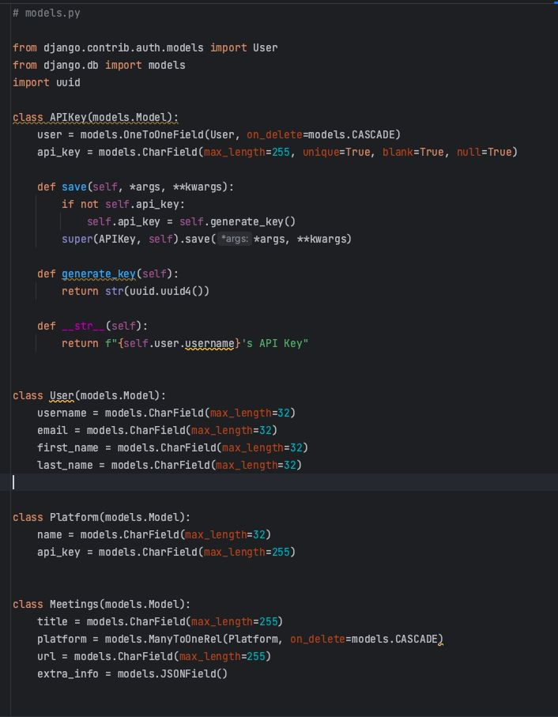
Technical Development / Architecture
What architecture are we using:
Backend: Django
Frontend: Figma React Database: SQL

Slide 9
Next Steps
Technical Prerequisites: After meeting with Prof. Shapiro on Wednesday, our team has sent over a detailed list of prerequisites necessary for the project’s technical implementation to Trace3.
Plan B Preparedness: If we don’t receive critical items (such as configured data), we’ll pivot to Plan B by generating dummy data to maintain progress.
Frontend Development: We’ve started work on the portal’s login page and will continue to develop and refine additional front end components.
Backend Development: We will start Backend work this week, ensuring we stay on schedule and meet our communication deadlines.

Slide 10
Thank You!
Open to questions.

